Slide 1
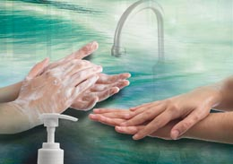
Hand Hygiene

Slide 2
Learning objectives
Describe the relevance of hand hygiene for infection prevention
Discuss strategies to improve hand hygiene compliance
Compare products available for hand hygiene
Explain current recommendations on hand hygiene practice

Slide 3
Time involved
50 minutes

Slide 4
Key points
Most effective single measure to prevent HAI
Compliance often suboptimal, influenced by many factors
Can be performed with soap and water or ABHR
WHO recommends ABHR for routine HH
HH promotion impacts practices and HAI
Strategies: hand rubs, water, soap, towels, education, monitoring, reminders and promotion of safety climate
Notes:
Hand hygiene is the most effective single measure to prevent transmission of healthcare-associated pathogens. Compliance with hand hygiene recommendations is often suboptimal and is influenced by many factors, including equipment/supplies, time constraints, and behavioural factors.
Hand hygiene can be performed either by washing with soap and water or by rubbing with an alcohol-based hand rub. The World Health Organization recommends the preferred use of alcohol-based hand rub (ABHR) for routine hand hygiene in health care.
Hand hygiene promotion and multimodal improvement strategies have a great impact on healthcare worker practices and can reduce healthcare-associated infections (HAI) and the spread of resistant microorganisms. Effective strategies include: provision of alcohol-based hand rubs and clean water, soap, and disposable towels; staff education; monitoring of hand hygiene practices and performance feedback; reminders in the work place; and promotion of a patient safety climate.

Slide 5
Background
A measure of personal hygiene for centuries
Semmelweis and Wendell Holmes established infection transmission by hands (1800)
First international guidelines in 2009
Contaminated hands are the commonest route of transmission of HAIs
Hand hygiene is the most effective measure to prevent HAIs
Notes:
Hand washing with soap and water has been considered a measure of personal hygiene for centuries. In the mid-1800s, studies by Ignaz Semmelweis in Vienna, Austria, and Oliver Wendell Holmes in Boston, Massachusetts, USA, established that hospital-acquired infections were transmitted via the hands of healthcare workers (HCW). Following the observation of high maternal mortality rates due to puerperal fever, Semmelweis made physicians wash their hands in a chlorinated lime solution before every patient contact.
Our knowledge of the transmission of pathogens through hands and of infection prevention has greatly evolved. The first international guidelines on hand hygiene published in 2009 recommend a range of evidence-based actions. Contaminated HCWs’ hands are the commonest route of transmission of HAIs. Hand hygiene is therefore the most effective measure to prevent HAIs.

Slide 6
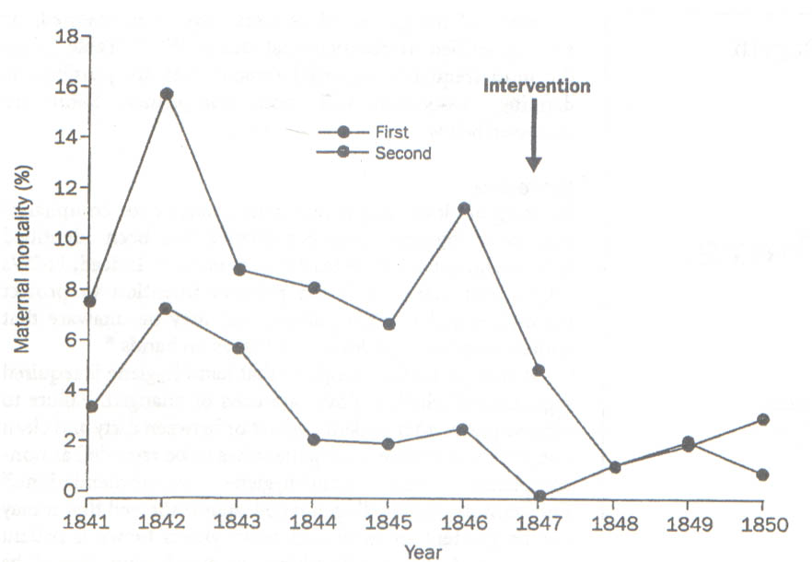
Maternal Mortality: Lying-in Women’s Hospital, Vienna 1841-1850
Notes:
In the mid-1800s, Ignaz Semmelweis in Vienna, Austria, followed up on his observation of high maternal mortality rates due to puerperal fever. He made physicians wash their hands in a chlorinated lime solution before every patient contact and with environmental surfaces and reduced the mortality rate.

Slide 7
Skin flora
Resident flora less likely to be associated with HAI
Transient flora can cause HAIs
Some activities lead to heavier hand contamination due to contact with patients or environment
Notes:
Resident or transient microbial flora is present on normal human skin. The resident flora is protective and less likely to be associated with HAIs. However, they can cause contamination of sterile body cavities, eyes, or non-intact skin.
Transient flora colonise the superficial layers of the skin. They frequently cause HAIs as they are acquired and passed on by HCWs during direct contact with patients or contaminated environmental surfaces.
Some activities (e.g., direct patient contact, contact with body fluid or waste, diaper change, and respiratory care) lead to heavier hand contamination.

Slide 8
Risk factors of hand contamination
Contact with body fluids
Diseased fingernails
Dermatitis or skin lesions
Subungual areas
Skin underneath rings
Artificial nails
Notes:
HCWs with dermatitis or skin lesions on their hands may remain colonised with acquired microorganisms for a long time. Subungual (beneath the nails) areas of the hand carry high concentrations of bacteria and yeasts. Artificial nails may also contribute to the transmission of pathogens as wearers are more likely to harbour Gram-negative pathogens on their fingertips than those with natural nails, despite hand washing or rubbing with an alcohol-based product. Diseased fingernails reduce the efficacy of hand hygiene.
The skin underneath rings (including wedding rings) is more heavily colonised than that on other fingers. Rings with sharp and voluminous surfaces and long, sharp fingernails, either natural or artificial, can puncture gloves and limit HCWs’ hand hygiene performance.

Slide 9
Hand contamination
HCWs can contaminate their hands or gloves with many pathogens
Staphylococcus aureus, Enterococci, Clostridium difficile, Gram-negative bacilli, and some viruses
By touching patients, body fluids or environment
Notes:
HCWs can contaminate their hands or medical gloves with pathogens, such as Staphylococcus aureus, enterococci, Clostridium difficile, Gram-negative bacilli, and some viruses (e.g., respiratory syncytial virus and rhinovirus), by touching infected sites and draining wounds, as well as patient skin or contaminated surfaces within the health care environment, especially surrounding the patient.

Slide 10
Compliance among HCW - 1
Many determinants
lack of time, equipment/supplies, behavioural factors
HH compliance < 40% without intervention
Compliance varies by:
work intensity
type of ward
professional category
time of day/week
Notes:
Without adequate hand hygiene, hand contamination increases and contaminated HCWs’ hands have been associated with endemic HAIs. Therefore, hand hygiene is the primary measure to prevent HAIs and will help decrease the spread of antimicrobial resistance. However, many determinants, such as lack of time, lack of equipment/supplies, and behavioural factors, often result in HCWs neglecting hand hygiene.
Although many HCWs perceive their performance as high, their hand hygiene compliance is usually < 40% in the absence of interventions. Hand hygiene performance varies according to work intensity, type of ward, professional category, and time of day/week.

Slide 11
Compliance among HCW - 2
Lower compliance:
high care intensity (e.g., ICU)
among physicians
before touching a patient
Better compliance:
after exposure to body fluids
after glove use
after contact with the patient or environment
Notes:
Compliance is usually lower in settings with high care intensity (e.g., intensive care units), among physicians, and before rather than after touching a patient. HCWs tend to comply more frequently with indications that protect themselves (e.g., after exposure to body fluids, after glove use, after contact with the patient or the patient’s environment).

Slide 12
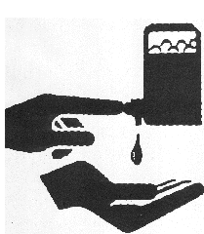
Hand Hygiene Products
Alcohol-based formulation or soap and water
Plain soap has minimal antimicrobial activity but mechanical friction removes many transient microorganisms
Notes:
Hand hygiene can be performed either by rubbing with an alcohol-based formulation or by washing with soap and water. Soaps are available as bar, leaf, powder, and liquid, but must be placed alongside running water, and re-stocked when needed to achieve compliance.
Plain soap has minimal antimicrobial activity, however it can be used for hand washing because mechanical friction removes many transient microorganisms.

Slide 13
Antimicrobials Products
Alcohol
Chlorhexidine
Chloroxylenol
Hexachlorophene
Iodine
Iodophor
Quaternary ammonium
Triclosan
Notes:
The commonest antimicrobials in hand hygiene products are: alcohols, chlorhexidine, chloroxylenol, hexachlorophene, iodine and iodophors, quaternary ammonium compounds, and triclosan.

Slide 14
Antimicrobials in HH
All effective against Gram-positive and Gram-negative
Maximal efficacy - alcohol and iodophor
Alcohol is effective against mycobacteria, fungi and viruses
ethanol has greater activity against viruses than isopropanol
Iodophor and chlorhexidine have some activity against viruses
None has activity against spores
Notes:
All are effective against Gram-positive and Gram-negative bacteria with maximal efficacy demonstrated by alcohols and iodophors. Mycobacteria and fungi are most effectively eliminated by alcohols, and less so by chlorhexidine, chloroxylenol, and hexachlorophene.
Enveloped viruses (e.g., herpes simplex virus, human immunodeficiency virus, influenza virus, respiratory syncytial virus) are highly susceptible to alcohols; hepatitis B and C viruses require high concentrations (70-80%). Alcohols have also shown in vivo activity against some non-enveloped viruses (rotavirus, adenovirus, rhinovirus, hepatitis A virus, and enteroviruses).I n vitro virucidal activity against surrogate strains of norovirus was demonstrated by 70% alcohol-based formulations. Several norovirus outbreaks were controlled with preventive measures, including alcohol-based hand rubs. In general, ethanol has a greater activity against viruses than isopropanol.
None of these antiseptics has activity against bacterial spores or protozoan oocysts although the mechanical effect of washing with soap and water allows their partial removal.

Slide 15
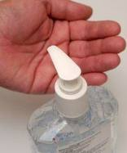
Alcohol hand-rub - 1
According WHO – preferred method
Broadest antimicrobial spectrum
Short time (20-30 sec)
Better skin tolerance
Available at the point of care
Notes:
According to the World Health Organization, alcohol-based hand rubs should be the preferred method for hand hygiene as they have the broadest antimicrobial spectrum, require a short time (20-30 seconds) for effective antimicrobial decontamination, have better skin tolerance, and are readily available at the point of care (i.e., where care is provided).
Alcohol-based hand rubs are available as rinses (with low viscosity), gels, foams, and impregnated wipes. However, wipes and foams have little supporting evidence. Gels were considered to have a low microbicidal efficacy; however newer formulations are more bactericidal.

Slide 16
Alcohol hand-rub - 2
Efficacy depends on
Concentration and quality
Amount used
Time spent
Coverage of the hands’ surfaces
Technique
Notes:
The efficacy of an alcohol-based hand rub depends on its quality, the amount used, the time spent rubbing, and complete coverage of the hands’ surfaces. These parameters also apply to washing with soap and water.
Hand rubs containing 60–80% alcohol are satisfactory, provided that they meet recommended standards (European Norms [EN - http://www.cen.eu/cen/products/en/pages/default.aspx] or American Society for Testing and Materials [ASTM - http://www.astm.org/] standards).
75-87% ethanol, isopropanol, or n-propanol, or a combination of these products guarantee the optimal antimicrobial efficacy. The WHO-recommended formulations contain either 75% v/v isopropanol, or 80% v/v ethanol.

Slide 17
Time of efficacy
The Lancet Infectious Diseases, vol 1, Pittet D, Boyce
Notes:
The time-course of efficacy of unmedicated soap and water and alcohol-based hand rub in reducing the release of test bacteria from artificially-contaminated hands.
From Pittet D, Boyce J, Hand hygiene and patient care: pursuing the Semmelweis legacy. The Lancet Infectious Diseases 2001; 1: 14. http://dx.doi.org/10.1016/S1473-3099(09)70295-6

Slide 18
Points to consider in product selection
Antimicrobial efficacy
Good tolerance and minimal reactions
Minimum drying time
Aesthetic preferences of HCWs/patients
Availability, convenience, and functioning of dispensers
Notes:
When selecting a HH product, consider the following:
demonstrated antimicrobial efficacy according to ASTM or EN standards for hygienic hand antisepsis and/or surgical hand preparation;
proven good dermal tolerance and minimal skin reactions;
minimum drying time (products that require longer drying times may affect hand hygiene best practice);
cost;
aesthetic preferences of HCWs and patients, such as fragrance, colour, texture, “stickiness”, and ease of use;
availability, convenience, and functioning of dispensers, and
ability to prevent contamination

Slide 19
Notes:
Hand hygiene technique with an alcohol-based formulation.
REFERENCE: Based on the hand hygiene technique with an alcohol-based formulation, URL: http://www.who.int/gpsc/5may/tools/system_change/en/index.html © World Health Organization 2009. All rights reserved.

Slide 20
Notes:
Hand washing technique with soap and water
Reference: Based on the hand washing technique with soap and water, URL: http://www.who.int/gpsc/5may/ tools/system_change/en/index.html © World Health Organization 2009. All rights reserved.

Slide 21
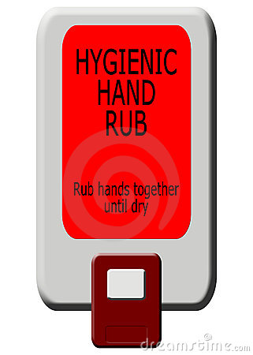
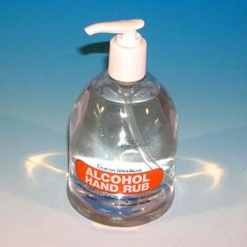
Placement Issues
Notes:
A rational location of facilities (sinks, soap, and hand rub dispensers), as well as good maintenance and user-friendliness, are essential. Ideally, different alcohol-based hand rub dispensers, e.g., pocket bottles, wall mounted, or those placed on carts/trolleys, night stand/bedside table, or affixed to the bed rail, should be used.

Slide 22
When to Perform Hand Hygiene
“My five moments” (WHO)
A unified vision to minimise individual variation
before touching a patient
before clean/aseptic procedures
after body fluid exposure/risk
after touching a patient
after touching patient surroundings
Notes:
The “My five moments for hand hygiene” approach merges the hand hygiene indications recommended by the WHO Guidelines into five moments when hand hygiene is required. This approach proposes a unified vision for HCWs, trainers, and observers to minimise inter-individual variation
The moments are:
before touching a patient,
before clean/aseptic procedures,
after body fluid exposure/risk,
after touching a patient, and
after touching patient surroundings.

Slide 23
Notes:
My five moments for hand hygiene”
REFERENCE: http://www.who.int/gpsc/5may/background/5moments/en/

Slide 24
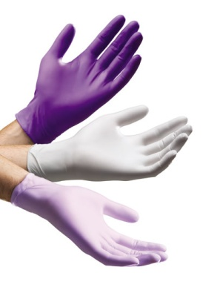
Glove use - 1
Prevent contamination of HCWs’ hands, reduce transmission of pathogens, and help control outbreaks
Does not prevent HAI unless accompanied by other measures, including HH
Must be used according indications
Do not use the same gloves for several hours
Notes:
Gloves prevent contamination of HCWs’ hands, reduce transmission of pathogens, and help control outbreaks. However, gloves do not prevent microorganism transmission and HAI unless rigorously accompanied by other measures, including hand hygiene. Gloves must be used according to established indications for donning and removal.
Use of the same gloves for several hours, while providing care to different patients and touching multiple surfaces, is a very frequent malpractice.
Understanding that glove use does not replace hand hygiene is of utmost importance.

Slide 25
Glove use - 2
Association between inappropriate use and low compliance with HH
Glove use does not replace HH
HH must be performed before donning gloves, as well as immediately after glove removal
Gloves must be removed to perform HH
Notes:
Several studies have established an association between inappropriate glove use and low compliance with hand hygiene. Others have found that HCWs wearing gloves were significantly more likely to cleanse their hands following patient care.
When there is a need for performing hand hygiene before a care act which also requires glove use, hand washing or hand rubbing must be performed before donning gloves, as well as immediately after glove removal.
In addition, gloves must be removed to perform hand washing or hand rubbing to protect a body site from the flora of another body site or skin area previously touched within the same patient

Slide 26
Improvement Strategies - 1
System change (necessary infrastructure)
access to water, soap, and disposable towels
provision of alcohol-based hand rub at the point of care
Training/education
on microbial transmission through hands and HH
Evaluation and feedback
direct observation
electronic monitoring
alcohol-based hand rub consumption
Notes:
Key components of successful strategies are:
System change
Ensure that the necessary infrastructure is in place to allow HCWs to practice hand hygiene at the point of care. This includes two essential elements: access to a safe, continuous water supply, soap, and disposable towels; and provision of alcohol-based hand rub at the point of care.
Training/education
Provide regular training on microbial transmission through HCWs’ hands and the importance of hand hygiene based on the “My five moments for hand hygiene” approach. Also include the correct procedures for hand rubbing and hand washing by using presentations, e-learning modules, posters, focus groups, reflective discussion, videos, self-learning modules, practical demonstrations, feedback from assessment, buddy systems, or combinations of these methods. Assess the impact of training on HCWs’ knowledge to identify areas for further education.
Evaluation and feedback
Monitor hand hygiene practices and knowledge among HCWs and feedback of results to staff . The gold standard for measuring hand hygiene compliance is direct observation; electronic monitoring of hand hygiene actions and evaluation of alcohol-based hand rub consumption can be used as indirect methods and surrogate markers.

Slide 27
Improvement strategies - 2
Reminders in the workplace
Institutional safety climate
active participation at institutional and individual levels
awareness of capacity to change and improve
partnership with patients and patient organisations
Notes:
Reminders in the workplace
Remind HCWs about the importance of hand hygiene and the indications and procedures for performing it.
Institutional safety climate
Create an environment and perceptions that raise awareness about patient safety while making hand hygiene a high priority at all levels, including: active participation at institutional and individual levels; awareness of individual and institutional capacity to change and improve (self-efficacy); and partnership with patients and patient organisations (depending on cultural issues and resources available).

Slide 28
Applicable Guidelines
Multimodal Hand Hygiene Improvement Strategy and Implementation Toolkit (WHO)
Pilot tested in settings with different levels of resources
significant improvement of practices, HCWs’ perception of HAI and its prevention
substantial improvement in the facilities and equipment including low-cost provision of alcohol based hand rubs through local production
Notes:
The WHO Multimodal Hand Hygiene Improvement Strategy and the WHO Implementation Toolkit have been developed to assist health care facilities to implement improvements in hand hygiene in accordance with Hand Hygiene. They have been pilot tested by the WHO in settings with different levels of resources and in a multicultural environment and produced significant improvement of practices, as well as HCWs’ perception of HAI and its prevention, and their knowledge about hand transmission and hand hygiene. Furthermore, a substantial improvement was achieved in the facilities and equipment available for hand hygiene, including the low-cost provision of alcohol based hand rubs through local production of the WHO-recommended formulations where these were not available commercially.
REFERENCES:
World Health Organization. Guide to local production: WHO recommended handrub formulations. 2010. Available from: http://www.who.int/gpsc/5may/Guide_to_Local_Production.pdf
World Health Organization. WHO Implementation Toolkit. 2010. Available from: http://www.who.int/gpsc/5may/tools/en/index.html

Slide 29
Current recommendations
World Health Organization
Notes:
Ranking system used for evidence (noted on subsequent slides):
Category IA. Strongly recommended for implementation and strongly supported by well-designed experimental, clinical, or epidemiological studies
Category IB. Strongly recommended for implementation and supported by some experimental, clinical, or epidemiological studies and a strong theoretical rationale.
Category IC. Required for implementation, as mandated by federal and/or state regulation or standard.
Category II. Suggested for implementation and supported by suggestive clinical or epidemiological studies or a theoretical rationale or a consensus by a panel of experts.
REFERENCE: World Health Organization. WHO Guidelines on Hand Hygiene in Health Care. Geneva: World Health Organization; 2009. Available from: htpp://whqlibdoc.who.int/publications/2009/9789241597906_eng.pdf

Slide 30
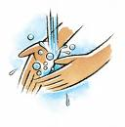
Indications for HH - 1
Soap and water
when visibly dirty or visibly soiled (IB)
after using the toilet (II)
exposure to potential spore-forming pathogens including outbreaks of C. difficile (IB)
Alcohol-based hand rub in all other situations (IA)
Soap and alcohol-based hand rub should not be used concomitantly (II)

Slide 31
Indications for HH - 2
Perform hand hygiene:
before and after touching the patient (IB)
before handling an invasive device regardless gloves (IB)
after contact with body fluids, mucous membranes, nonintact skin, or wound dressings (IA)
if moving from a contaminated body site to another body site of the same patient (IB)
after contact with inanimate surfaces in the immediate vicinity of the patient (IB)
after removing sterile (II) or non-sterile gloves (IB)
Before handling medication or preparing food (IB)

Slide 32
Hand hygiene technique
Cover all surfaces of the hands with alcohol-based hand rub. Rub hands until dry (IB)
When use soap and water, cover all surfaces. Dry with a single-use towel. Clean, running water whenever possible. Avoid hot water, as exposure may increase the risk dermatitis (IB)
Use a towel to turn off tap/faucet (IB)
Dry hands using a method that does not recontaminate hands. Make sure towels are single use (IB)
All forms of soap are acceptable. When bar soap is used, small bars that facilitate drainage should be used to allow the bars to dry (II)

Slide 33
Surgical hand preparation - 1
Remove rings, wrist-watch, and bracelets (II)
Artificial nails are prohibited (IB)
Sinks should be designed to reduce splashes (II)
If hands are visibly soiled, wash with soap before (II)
Remove debris from underneath fingernails (II)
Brushes are not recommended (IB)
Use antimicrobial soap or alcohol-based hand rub, preferably with sustained activity (IB)
If quality of water is not assured use an alcohol-based hand rub before sterile gloves (II).
When use antimicrobial soap, scrub hands and forearms 2–5 minutes. Long scrub times are not necessary (IB)

Slide 34
Surgical hand preparation - 2
When using an alcohol-based surgical hand rub
follow manufacturer’s instructions for application times
apply the product to dry hands only (IB)
not combine surgical hand scrub and surgical hand rub with alcohol-based products sequentially (II)
use sufficient product to keep hands and forearms wet throughout the procedure (IB)
After application, allow hands and forearms to dry thoroughly before donning sterile gloves (IB)

Slide 35
Selection and handling of hand hygiene agents - 1
Products with low irritancy (IB)
With input of HCW acceptance (skin tolerance, feel, and fragrance) (IB)
Knowledge about interaction between HH, skin care products and types of gloves (II)
Information about the risk of product (IB)
Dispensers must ensure
accessibility at the point of care (IB)
function (II)
system for alcohol-based hand rubs approved for flammable materials (IC)

Slide 36
Selection and handling of hand hygiene agents - 2
Evaluate information about effect that lotions, creams or alcohol-based hand rubs may have on the effects of antimicrobial soaps (IB)
Cost comparisons only for products that meet requirements (II)
Do not add soap (IA) or alcohol-based formulations (II) to a partially empty soap dispenser

Slide 37
Skin care
Education about how to reduce risk of dermatitis and skin damage (IB)
Alternative products for HCWs with allergies or adverse reactions to standard products (II)
Hand lotions or creams (IA)
When alcohol-based hand rub is available the use of antimicrobial soap is not recommended (II)
Soap and alcohol-based hand rub should not be used concomitantly (II)

Slide 38
Use of gloves
Does not replace HH (IB)
Wear when anticipated contact with blood or other potentially infectious materials, (IC)
Remove gloves after caring. Not the same pair for the care of more than one patient (IB)
Change or remove gloves if moving from a contaminated body site to another within the same patient or the environment (II)
The reuse of gloves is not recommended (IB)
In the case of glove reuse, implement the safest reprocessing method (II)

Slide 39
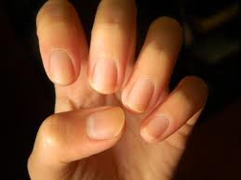
Other aspects of hand hygiene
No artificial fingernails or extenders when having direct contact with patients (IA)
Natural nails short
tips less than 0.5 cm long or approximately ¼ inch (II)

Slide 40
Educational and motivational programs for healthcare workers
Focus on factors that influence behavior not only on products. Multimodal strategy (education/support) (IA)
Educate about hand contamination and advantages and disadvantages of methods for HH (II)
Monitor adherence to HH and feedback (IA)
Partnerships between patients, families and HCWs (II)

Slide 41
Governmental and institutional responsibilities for health care administrators
Safe, continuous water supply and access in the facilities (IB)
Alcohol-based hand rub at the point of care (IA)
Improved hand hygiene adherence as a priority (IB)
Time for infection control training (II)
Multidisciplinary, multifaceted and multimodal program to improve adherence of HH (IB)
Water supply separated from drainage and sewage system to monitor and management (IB)
Leadership and support for HH and IC (II)
Alcohol-based hand rub production and storage according to guidelines and legal requirements (II)

Slide 42
For National Governments
HH adherence a national priority. Consider funded programm ensuring sustainability (II)
Support strengthening of infection control in healthcare settings (II)
Promotion of HH in the community (II)
Encourage healthcare settings to use HH as a quality indicator (II)

Slide 43
Summary
Hands play a crucial role in transmission of microorganisms
HH is the single most effective measure to prevent HAI
HH practice usually suboptimal
Improvement achieved by multimodal strategies
Alcohol-based hand rubbing is the gold standard for HH
Identification of the right moments is essential
Notes:
Healthcare workers’ hands play a crucial role in the transmission of microorganisms during the sequence of care and contact with environmental surfaces and patients’ skin. Hand hygiene is the single most effective measure to prevent healthcare-associated infection. However, hand hygiene practice at the right moment with proper technique is usually sub-optimal among HCWs due to many constraints and behavioural factors.
Improvement of practices can be achieved and lead to substantial reduction of transmission by multimodal strategies aimed at strengthening infrastructure, knowledge, and the institutional patient safety culture. The preferred use of alcohol-based hand rubbing as the gold standard for hand hygiene and the identification of the right moments for hand hygiene during patient care are essential elements for success.
The World Health Organization has promoted innovative concepts and strategies to achieve hand hygiene improvement worldwide in close collaboration with other key players and stakeholders in the field of infection prevention and control, such as the International Federation of Infection Control.

Slide 44
References
Boyce JM, Pittet D. Guideline for hand hygiene in health-care settings. Morb Mortal Wkly Rep Recomm 2002 25; 51:1-45. http://www.cdc.gov/mmwr/PDF/rr/rr5116.pdf
World Health Organization. Alcohol-based handrub planning and costing tool 2010. Available from: http://www.who.int/gpsc/5may/tools/system_change/en/index.html
Allegranzi B, et al. Successful implementation of the World Health Organization hand hygiene improvement strategy in a referral hospital in Mali, Africa. Infect Control Hosp Epidemiol 2010; 31:133-41.

Slide 45
References
World Health Organization. Hand hygiene technical reference manual. 2010. Available from: http://www.who.int/gpsc/5may/tools/training_ education/en/index.html
Sax H, et al. “My five moments for hand hygiene”: a user-centred design approach to understand, train, monitor and report hand hygiene. J Hosp Infect 2007; 67:9-21.
Allegranzi B, Pitt et D. Role of hand hygiene in healthcare-associated infection prevention. J Hosp Infect 2009; 73:305-15.

Slide 46
Key web sites
Centers for Disease Control and Prevention: Hand Hygiene in Healthcare Settings. http://www.cdc.gov/HandHygiene/index.html
Germs. Wash your hands of them: http://www.washyourhandsofthem.com/home.aspx
Hand Hygiene Resource Centre: http://www.handhygiene.org/
Institute for Healthcare Improvement (IHI): http://www.ihi.org/knowledge/Pages/Tools/HowtoGuideImprovingHandHygiene.aspx
National Resource for Infection Control (NRIC): http://www.nric.org.uk/IntegratedCRD.nsf/CleanYourHands2010?OpenForm

Slide 47
Quiz
Gloves use can replace hand hygiene in routine work? T/F
In a multimodal strategy to improve hand hygiene, which of the following should be included:
Structural elements
Health care education
Reminders
All of the above
Alcohol based hand rub solutions are the gold standard for HH mainly because they:
Are cheaper
Reduce time of HH with similar efficacy
Can be prepared in the same hospital
Are recommended by WHO
Notes:
False
D
3. B

Slide 48
International Federation of Infection Control
IFIC’s mission is to facilitate international networking in order to improve the prevention and control of healthcare associated infections worldwide. It is an umbrella organisation of societies and associations of healthcare professionals in infection control and related fields across the globe .
The goal of IFIC is to minimise the risk of infection within healthcare settings through development of a network of infection control organisations for communication, consensus building, education and sharing expertise.
For more information go to http://theific.org/

